Slide 1
Lecture No. 13 Metal Finishing
At the end of this lecture, student will be able to:
Explain metal finishing and its technological importance
Describe decomposition potential, Over voltage and polarization

Slide 2


Metal Finishing
Process carried out in order to modify the surface properties of metal
Involves deposition of a layer of metal or a polymer on another metal
Conversion of surface layer into its oxide films or
any other inorganic compound film and any
such processes which ultimately modify the
surface properties of metal

Slide 3
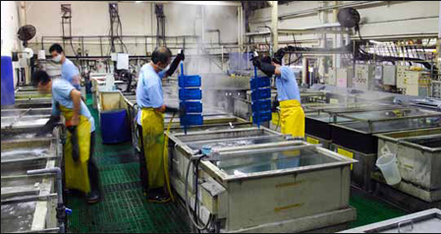
Metal Finishing
Definition
It is a process of modifying surface properties of substrates (metals , plastics) by deposition of a layer of another metal or polymer on its surface
To bring about intended better surface characteristics

Slide 4

Technological Importance:
Corrosion resistance
Hardness, strength, wear / abrasion resistance, etc.
Thermal conductance or resistance or reflectance, etc.
Optical reflectance
Electrical conductance or insulation, etc.

Slide 5

Technological Importance
Building up material or restoration
Manufacturing printed circuit boards, capacitors, contacts, etc.
Electrotyping (e.g., gramophone records)
Electroforming or reforming of articles
Electrochemical machining, electropolishing and electrochemical etching, etc.

Slide 6
Techniques of Metal Finishing
There are 3 important techniques of metal finishing:
Electroplating of metals or alloys by use of electricity / electrolysis
Electroless plating of metals or alloys by use of reducing agents
Immersion plating [by replacement reactions]

Slide 7
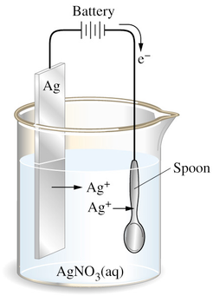


Electroplating
Definition
Process by which coating metal is deposited on the base metal by passing direct current through an electrolyte solution, containing the soluble salt of the coating metal
Common metals used are Cu, Ag, Ni, Zn, Au, Pt etc.
Used in industries for producing metal coating

Slide 8
Factors Governing Electroplating:
Since the process involves electrolysis, three important factors governing the process of electrolysis are
Polarization
Decomposition Potential
Over voltage

Slide 9
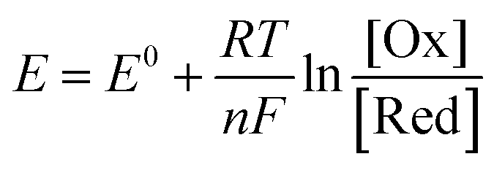
Polarization
Nernst equation
Definition
Occurs due to the variation of electrode potential due to inadequate supply of ionic species from the bulk of the solution to the electrode surface
Polarization sets in the cell when the electrode processes become slow and irreversible
Magnitude of over potential is directly proportional to the extent of polarization

Slide 10
Polarization
Factors affecting the electrode polarization:
Nature of the electrode: Electrodes with rough surface have low polarization
Nature of products formed at the electrode: If the products form a film on the surface, polarization increases
Nature of the electrolyte: Lower the concentration of the electrolyte, lower is the polarization
Temperature: Higher the temperature, lower is the polarization, because, at higher temperatures rate of diffusion of ions is higher
Rate of stirring of the electrolyte: Stirring helps in minimizing the polarization effects

Slide 11
Decomposition Potential
Decomposition potential is the experimentally determined
Definition
Minimum external potential that needs to be applied in order to have continuous decomposition of the electrolyte
For example:
1.68 V is the decomposition potential of water
Reason:
During electrolysis accumulation of products of electrolysis around the electrodes causes a back emf which opposes the applied emf
To overcome the back emf, the applied emf will have to be increased, then only electrolytic deposition starts again

Slide 12
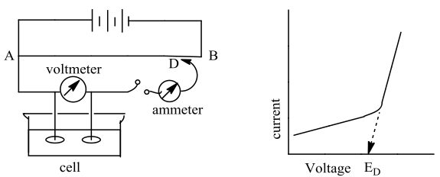
Decomposition Potential
Measurement of E_{d}:
Gradually increasing voltage is applied between the electrodes
Milliammeter reading is noted down for every voltage applied

Slide 13
Decomposition Potential
Factors Influencing E_{D}
Decomposition potentials of different electrolytes are different
Strength of the current flowing through the cell
Chemical nature of the electrodes
Physical nature of the electrodes
Activity of the electrolyte
Absolute temperature

Slide 14
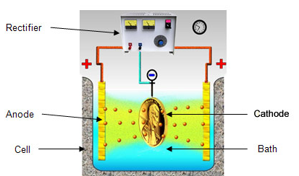
Decomposition Potential
Significance of decomposition potential
Used to carry out all electrolytic processes(electroplating, electrorefining etc.)
Used in the separation of ions from a solution by electrolysis
Two types of ions can be discharged simultaneously by equalizing their decomposition potentials

Slide 15
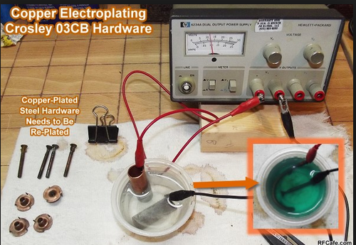
Over Voltage (ɳ)
Decomposition of an electrolyte is expected to start as soon as applied potential reaches the value of reversible emf of the cell
If gaseous product are discharged at the electrodes, then the actual decomposition potential is invariably much higher than its theoretical reversible electrode potential
Definition
Over voltage may be defined as excess voltage that has to be applied above the theoretical decomposition potential to start the electrolysis

Slide 16
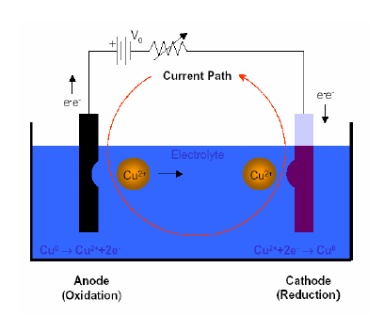
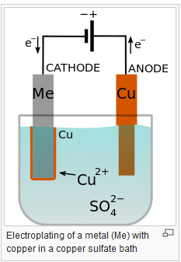

Reaction During Electroplating
Reactions at anode and cathode during electroplating:
Oxidation takes place at anode
When the anode used is an insoluble (inert) anode,
oxygen evolution occurs at the anode:
Reduction occurs at cathode
The metal gets deposited on the cathode surface.

Slide 17
Over Voltage
Definition:
Over voltage is the difference between the actual applied EMF to and the theoretical EMF to bring about continuous electrolysis
ɳ = Experimental decomposition potential - Theoretical decomposition potential
For example:
Decomposition potential of water over smooth platinum surfaces is 1.68 V
However, the theoretically calculated voltage (or reversible cell potential) is 1.23 V
Therefore, overvoltage is 1.68 – 1.23 = 0.45 V.
The decomposition potential for such systems is given by: ED = Ecathode – Eanode + ɳ

Slide 18
Factors Affecting Over voltage:
Nature and physical state of the electrode
Nature of the electrolyte
Temperature of the electrolytic bath
Current density at the electrode surface

Slide 19
Summary
Metal finishing: modification of the surface properties of metal
Technological Importance: Electrotyping, electroforming, PCB, etc.
Decomposition potential: Minimum external potential that needs to be applied in order to have continuous decomposition of the electrolyte
Over voltage: Over voltage is the difference between the actual applied EMF to and the theoretical EMF to bring about continuous electrolysis
Polarization: Variation of electrode potential due to inadequate supply of ionic species from the bulk of the solution to the electrode surface

